Slide 1
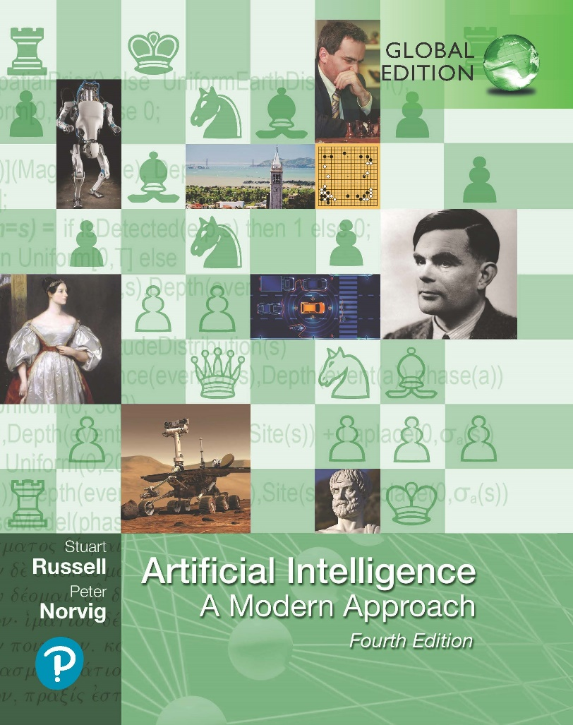
Artificial Intelligence: A Modern Approach
Fourth Edition, Global Edition
Chapter 24
Natural Language Processing
© 2022 Pearson Education Ltd.

Slide 2
Outline
Language Models
Grammar
Parsing
Augmented Grammars
Complications of Real Natural Language
Natural Language Tasks

Slide 3

Language Models
Language Models
Language judgments vary from person to person and time to time
Natural language is ambiguous and vague
The mapping from symbols to objects is not formally defined
Language model: a probability distribution describing the likelihood of any string
The bag-of-words model
The application of naive Bayes to strings of words
generative model that describes a process for generating a sentence
Given a sentence consisting of the words w₁, w₂, . . . w_{N}
Each category has a bag full of words
To generate text, first select one of the bags and discard the others
into that bag and pull out a word at random
the process of dividing a text into a sequence of words is called tokenization

Slide 4
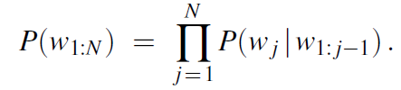
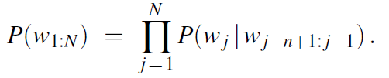
Language Models
N-gram word models
making a word dependent on all previous words in a sentence
captures all possible interactions between words, but it is not practical
a vocabulary of 100,000 words and a sentence length of 40, this model would have 10²⁰⁰ parameters to estimate.
Compromise with a Markov chain model
n-gram model: a sequence of written symbols of length n is called an n-gram, with special cases “unigram” for 1-gram, “bigram” for 2-gram, and “trigram” for 3-gram
In an n-gram model, the probability of each word is dependent only on the n− 1 previous words;

Slide 5
Language Models
Other n-gram models
character-level model
Probability of each character is determined by the n − 1 previous characters
for dealing with unknown words.
for languages that tend to run words together
well suited for the task of language identification
skip-gram model
count words that are near each but skip a word or more between them

Slide 6
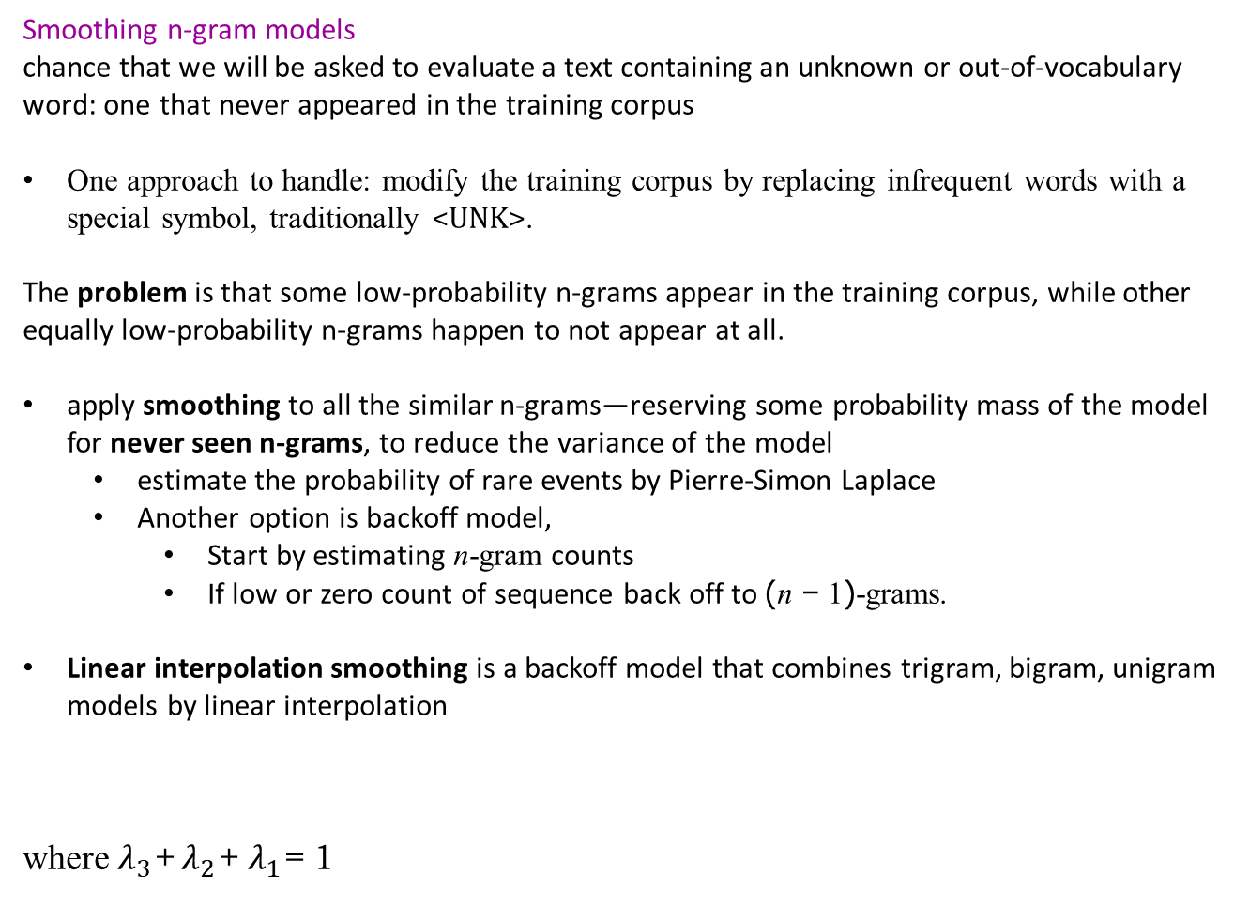
Language Models
Smoothing n-gram models
chance that we will be asked to evaluate a text containing an unknown or out-of-vocabulary word: one that never appeared in the training corpus
One approach to handle: modify the training corpus by replacing infrequent words with a special symbol, traditionally <UNK>.
The problem is that some low-probability n-grams appear in the training corpus, while other equally low-probability n-grams happen to not appear at all.
apply smoothing to all the similar n-grams—reserving some probability mass of the model for never seen n-grams, to reduce the variance of the model
estimate the probability of rare events by Pierre-Simon Laplace
Another option is backoff model,
Start by estimating n-gram counts
If low or zero count of sequence back off to (n − 1)-grams.
Linear interpolation smoothing is a backoff model that combines trigram, bigram, unigram models by linear interpolation
where $λ_{3}$+ $λ_{2}$+ $λ_{1}$= 1

Slide 7
Language Models
Word representations
The n-gram model misses this generalization because it is an atomic model
each word is an atom, distinct from every other word, with no internal structure
Dictionary: structured word model.
Wordnet :
open-source, hand-curated dictionary in machine readable format
help separate the nouns from the verbs,
get the basic categories

Slide 8
Language Models
Part-of-speech (POS) tagging
way to categorize words (lexical category/tag)
POS allows language models to capture generalizations such as “adjectives generally come before nouns in English”
useful first step in many other NLP tasks, such as question answering or translation
Hidden Markov model (HMM) is a common model for POS tagging
HMM is a generative model that says that the way to produce language is to start in one state, such as IN, the state for prepositions. Two choices:
What word should be emitted
What state should come next
A weakness of HMM models is that everything we know about language has to be expressed in terms of the transition and sensor models.
logistic regression
weights in the logistic regression model correspond to how predictive each feature is for each category;
the weight values are learned by gradient descent

Slide 9
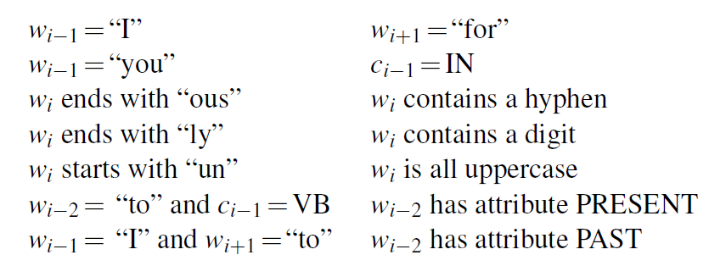
Language Models
A set of POS tagging features might include:
verb (VBP), past tense verb (VBD), noun (NN), present tense verb (VBP)

Slide 10
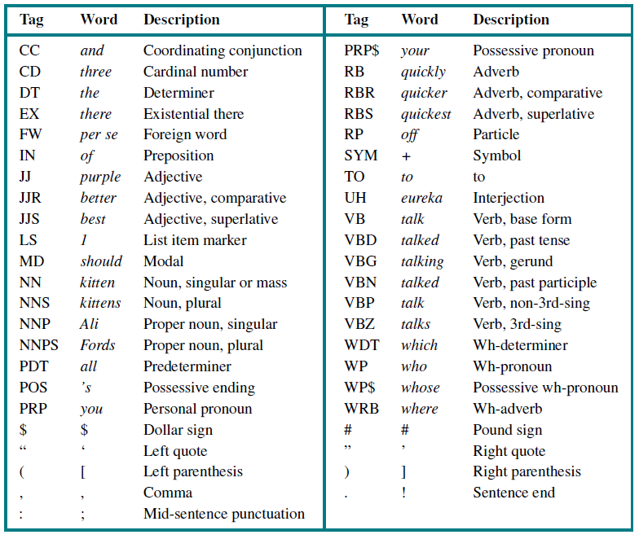
Language Models
Part-of-speech tags (with an example word for each tag) for the Penn Treebank corpus (Marcus et al., 1993). Here “3rd-sing” is an abbreviation for “third person singular present tense.”

Slide 11

Grammar
A grammar is a set of rules that defines the tree structure of allowable phrases
A language is the set of sentences that follow those rules.
Syntactic categories such as noun phrase or verb phrase help to constrain the probable words at each point within a sentence
The phrase structure provides a framework for the meaning or semantics of the sentence
Probabilistic context-free grammar (PCFG)
A probabilistic grammar assigns a probability to each string
“context-free” means that any rule can be used in any context
PCFG grammar applied to Wumpus World
will define a for a tiny fragment of English that is suitable for communication between agents exploring the Wumpus world language
Grammar rule

Slide 12
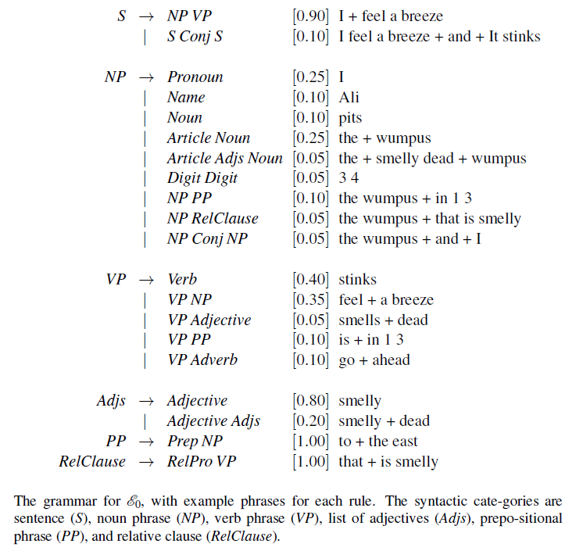
Grammar

Slide 13
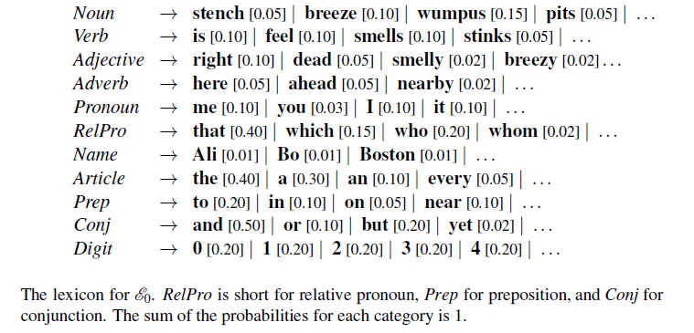
Grammar

Slide 14
Parsing
Parsing is the process of analyzing a string of words to uncover its phrase structure, according to the rules of a grammar.
Search for a valid parse tree whose leaves are the words of the string
can start with the S symbol and search top down, or we can start with the words and search bottom up.
Inefficiency: If the algorithm guesses wrong, it will have to backtrack all the way to the first word and reanalyze the whole sentence under the other interpretation.
dynamic programming: every time we analyze a substring, store the results so we won’t have to reanalyze it later.
Chart parser: records result in a data structure known as a chart

Slide 15
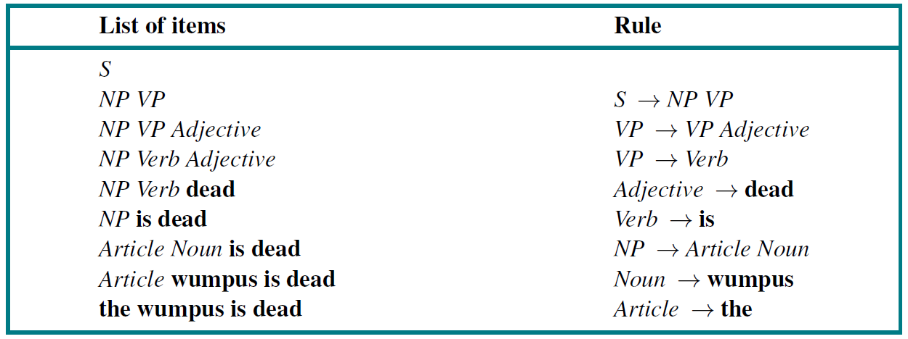
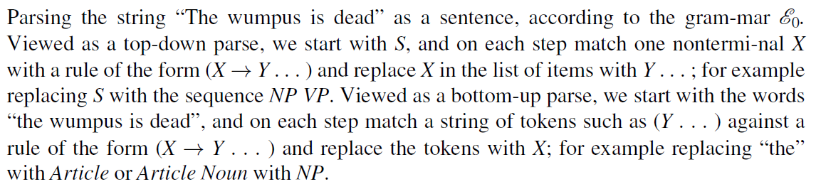
Parsing

Slide 16
Parsing

Slide 17
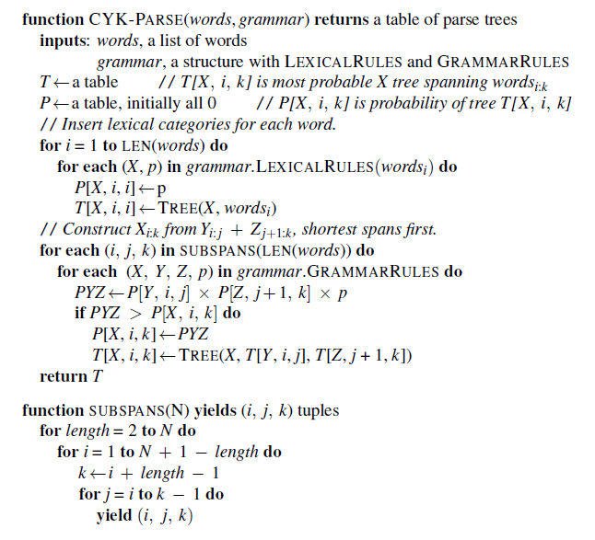
Parsing
The CYK algorithm for parsing.

Slide 18
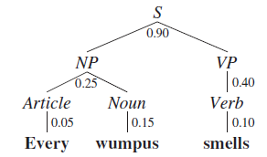
Parsing
Using A* search
don’t have to search entire state space
guaranteed that the first parse found will be the most probable (assuming an admissible heuristic).
faster than CYK, but (depending on the details of the grammar) still slower than O(n).
Parse tree for the sentence “Every wumpus smells” and probabilities:

Slide 19
Parsing
Using beam search
consider only the b most probable alternative parses
Not guaranteed to find the parse with highest probability
However parser can operate in O(n) time and still finds the best parse most of the time
beam search parser with b = 1 is called a deterministic parser.
Example: shift-reduce parsing
go through the sentence word by word
choosing at each point whether to shift the word onto a stack of constituents,
or to reduce the top constituent(s) on the stack according to a grammar rule

Slide 20
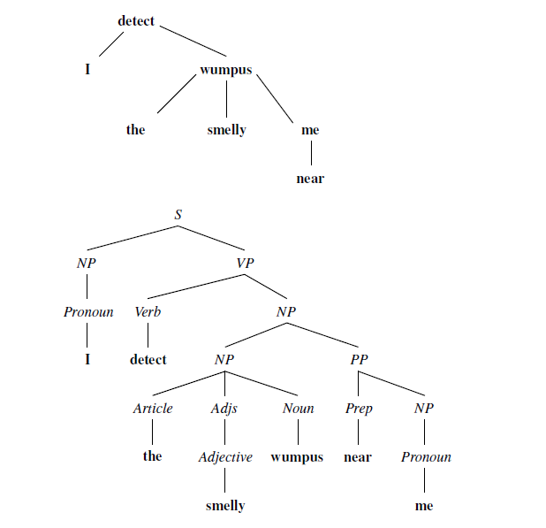
Parsing
A dependency-style parse (top) and the corresponding phrase structure parse (bottom) for the sentence I detect the smelly wumpus near me.

Slide 21
Parsing
Dependency parsing
dependency grammar:
assumes that syntactic structure is formed by binary relations between lexical items, without a need for syntactic constituents
phrase structure tree is annotated with the head of each phrase
recover dependency tree
Convert dependency tree to phrase structure with arbitrary categories

Slide 22
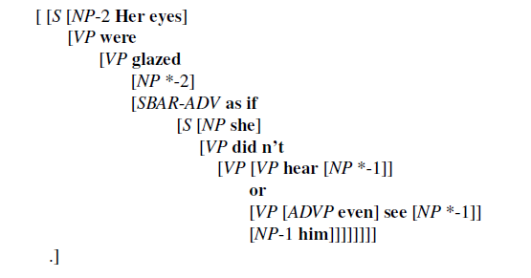
Parsing
Learning a parser from examples
Given treebank, create a PCFG just by counting the number of times each node-type appears in a tree (with the usual caveats about smoothing low counts)
Annotated tree for
“Here eyes were glazed as if she didn’t hear or even see him”

Slide 23
Parsing
Learning a parser from examples
If there are 1000 S nodes of which 600 are of this form, then we create the rule:
S → NP VP [0.6]
Penn Treebank has over 10,000 different node types
“the good and the bad” is parsed as a single noun phrase
Other approaches:
unsupervised parsing: learn new grammar (or improve an existing grammar) using a corpus of sentences without trees
curriculum learning: start with the easy part of the curriculum—short unambiguous 2-word sentences
semisupervised parsing: start with a small number of trees as data to build an initial grammar, then add a large number of unparsed sentences to improve the grammar.

Slide 24
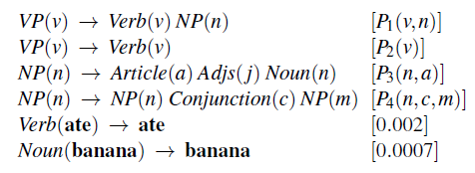
Augmented Grammars
Pronoun category
“I” : can be subject of a sentence, singular
“me” : cannot be subject of a sentence, plural
Pronoun that has been augmented with features like “subjective case, first person singular” is called a subcategory
Lexicalized PCFG: a type of augmented grammar that allows us to assign probabilities based on properties of the words in a phrase other than just the syntactic categories
The notation VP(v) denotes a phrase with category VP whose head word is v.
Here P₁(v, n) means the probability of a VP headed by v joining with an NP headed by n to form a VP.

Slide 25
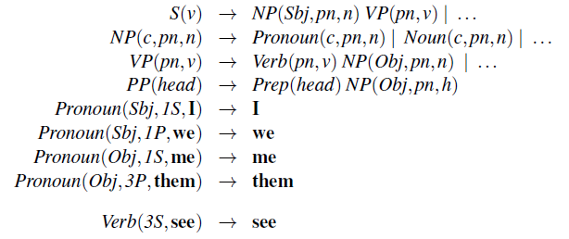
Augmented Grammars
encode facts completely in the probability entries, for example:
P₁(v, she) made a very small number, for all verbs v.
S(v) → NP(Sbj, pn, n) VP(pn, v) [P₅(n, v)]
NP is followed by a VP they can form an S, but only if the NP has the subjective (Sbj) case and the person and number (pn) of the NP and VP are identical.
Part of an augmented grammar that handles case agreement, subject–verb agreement,and head words.

Slide 26
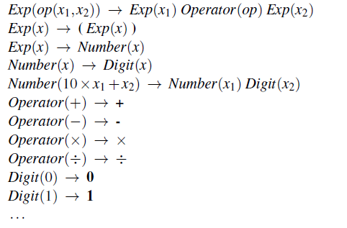
Augmented Grammars
Grammar for arithmetic expressions, augmented with semantics. Each variable x_{i} represents the semantics of a constituent.

Slide 27
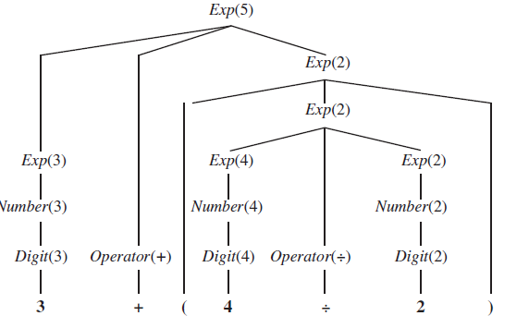
Augmented Grammars
Parse tree with semantic interpretations for the string “3 + (4 ÷ 2)”.

Slide 28
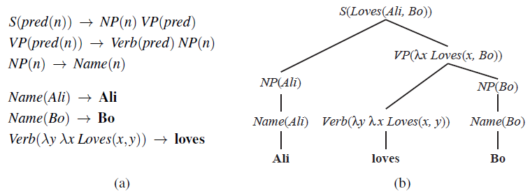
Augmented Grammars
A grammar that can derive a parse tree and semantic interpretation for “Ali loves Bo” (and three other sentences). Each category is augmented with a single argument representing the semantics.
A parse tree with semantic interpretations for the string “Ali loves Bo.”

Slide 29
Augmented Grammars
Learning semantic grammars
Sentence: What states border Texas?
Logical Form: λx.state(x) ∧λx.borders(x, Texas)
large collection of pairs like this and a little bit of hand-coded knowledge for each new domain, the system generates plausible lexical entries
much easier to gather examples of question/answer pairs:
Question: What states border Texas?
Answer: Louisiana, Arkansas, Oklahoma, New Mexico.
Question: How many times would Rhode Island fit into California?
Answer: 135

Slide 30
Complications of Real Natural Language
Quantification:
Standard approach: define not an actual logical semantic sentence, but rather a quasi-logical form that is then turned into a logical sentence by algorithms outside of the parsing process
have preference rules for choosing one quantifier scope over another
Pragmatics:
resolving the meaning of indexicals, which are phrases that refer directly to the current situation
Example sentence: “I am in Boston today,” both “I” and “today” are indexicals. The word “I” would be represented by Speaker, a fluent that refers to different objects at different times
interpreting the speaker’s intent
The speaker’s utterance is considered a speech act, and it is up to the hearer to decipher what type of action it is (question, a statement, a promise, a warning, a command, etc.)

Slide 31


Complications of Real Natural Language
Long-distance dependencies:
Standard approach: define not an actual logical semantic sentence, but rather a quasi-logical form that is then turned into a logical sentence by algorithms outside of the parsing process
have preference rules for choosing one quantifier scope over another
Time and tense:
English uses verb tenses (past, present, and future) to indicate the relative time of an event.
One good choice to represent the time of events is the event calculus notation

Slide 32
Complications of Real Natural Language
Ambiguity:
tend to think of ambiguity as a failure in communication
when a listener is consciously aware of an ambiguity in an utterance, it means that the utterance is unclear or confusing.
Lexical ambiguity is when a word has more than one meaning
“back” can be an adverb (go back),
an adjective (back door),
a noun (the back of the room),
a verb (back a candidate), or
a proper noun (a river in Nunavut, Canada).
Syntactic ambiguity
refers to a phrase that has multiple parses: “I smelled a wumpus in 2,2” has two parses: one where the prepositional phrase “in 2,2” modifies the noun and one where it modifies the verb.
Leads to semantic ambiguity,

Slide 33
Complications of Real Natural Language
Disambiguation is the process of recovering the most probable intended meaning of an utterance.
disambiguation requires combination of four models:
The world model: the likelihood that a proposition occurs in the world.
The mental model: the likelihood that the speaker forms the intention of communicating a certain fact to the hearer.
The language model: the likelihood that a certain string of words will be chosen, given that the speaker has the intention of communicating a certain fact.
The acoustic model: for spoken communication, the likelihood that a particular sequence of sounds will be generated, given that the speaker has chosen a given string of words.

Slide 34
Natural Language Tasks
Speech recognition is the task of transforming spoken sound into text.
We can then perform further tasks on the resulting text
Current systems have a word error rate of about 3% to 5%
The challenge: to respond appropriately even when there are errors on individual words.
Text-to-speech synthesis is the inverse process—going from text to sound
Machine translation transforms text in one language to another.
Information extraction is the process of acquiring knowledge by skimming a text and looking for occurrences of particular classes of objects and for relationships among them.
Information retrieval is the task of finding documents that are relevant and important for a given query
Question Answering is a different task, in which the query really is a question

Slide 35
Summary
Probabilistic language models based on n-grams recover a surprising amount of information about a language
Word embeddings can give a richer representation of words and their similarities.
To capture the hierarchical structure of language, phrase structure grammars (and in particular, context-free grammars) are useful
Sentences in a context-free language can be parsed in O(n³) time by a chart parser such as the CYK algorithm, which requires grammar rules to be in Chomsky Normal Form.
A treebank can be a resource for learning a PCFG grammar with parameters.
Semantic interpretation can also be handled by an augmented grammar.

